Slide 1
Strategic Analysis of Global YouTube Trends Using Tableau and Excel

Slide 2
Objective
This project focuses on analyzing YouTube’s global trends to provide data-driven business recommendations for content creators, marketers, and media companies. The goal was to identify subscriber growth patterns, top categories, and top regions.

Slide 3
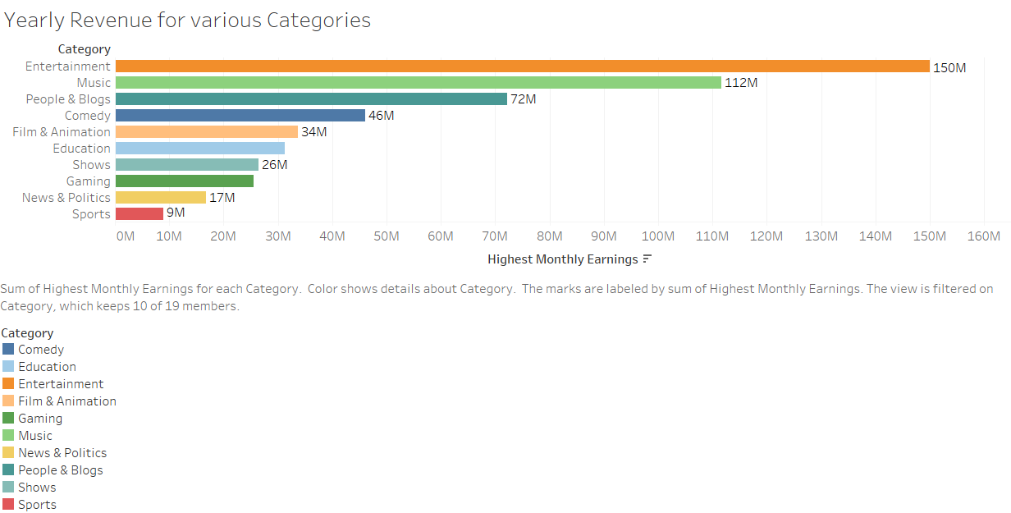
Top Revenue-Generating Categories
🔹 Entertainment: $150M🔹 Music: $112M🔹 Personal Blogs: $72M

Slide 4
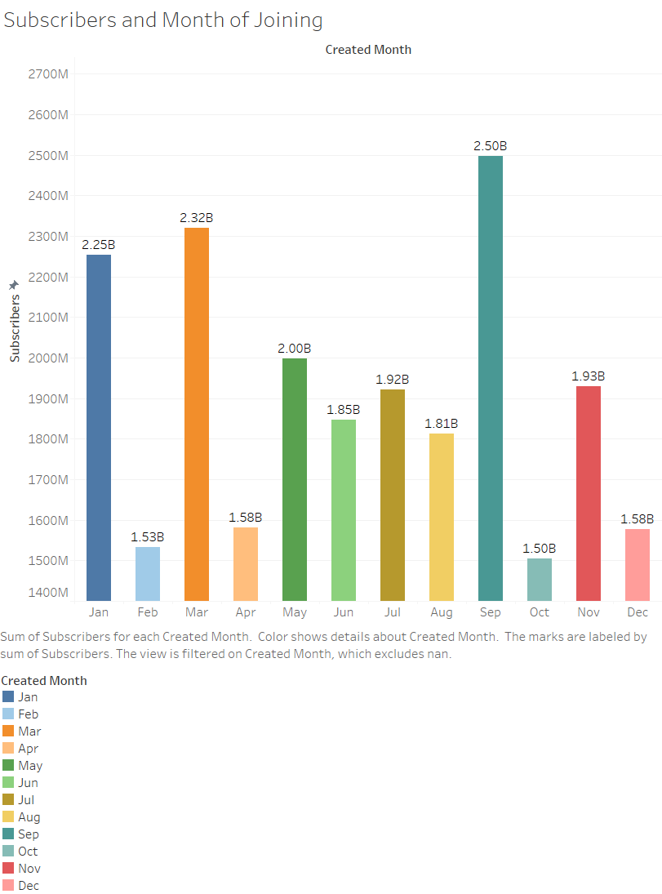
Peak Subscriber Acquisition Months
🔹 September: 2.5B🔹 March: 2.32B🔹 January: 2.25B

Slide 5
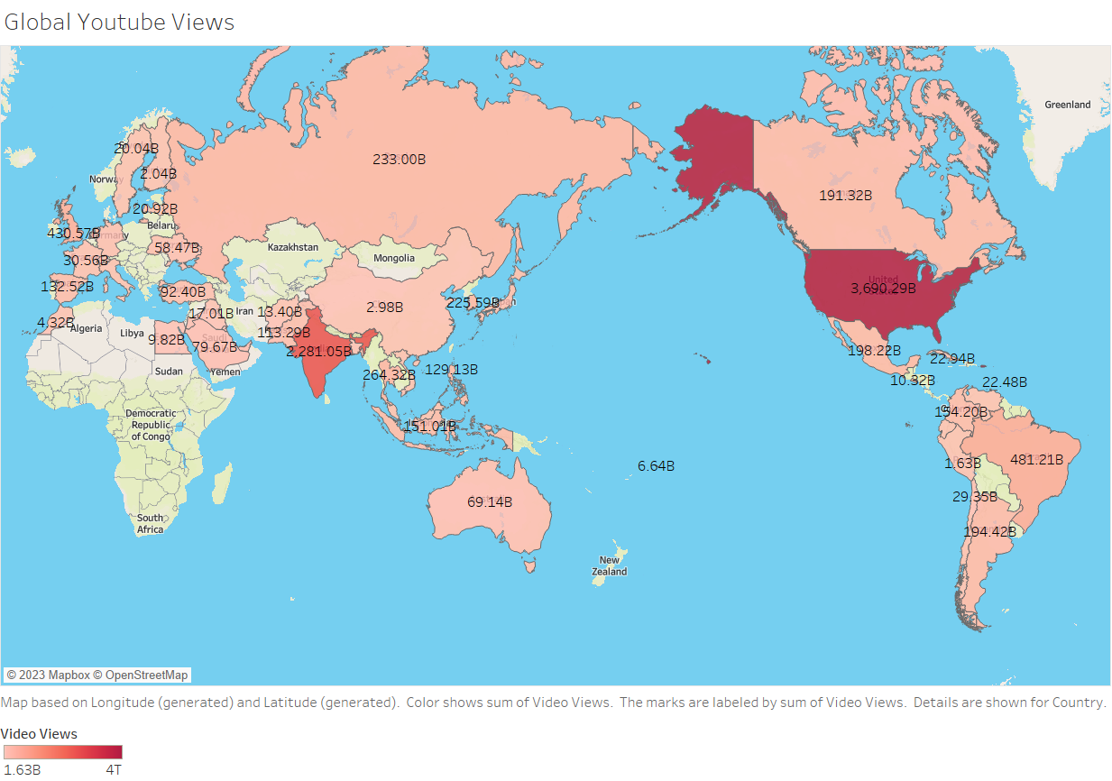
Top Countries by YouTube Viewership
🔹 United States🔹 India🔹 Brazil

Slide 6
Subscribers in Last 30 days of 2023
🔹 Entertainment: 65M🔹 People and Blogs: 35M🔹 Music: 25M

Slide 7
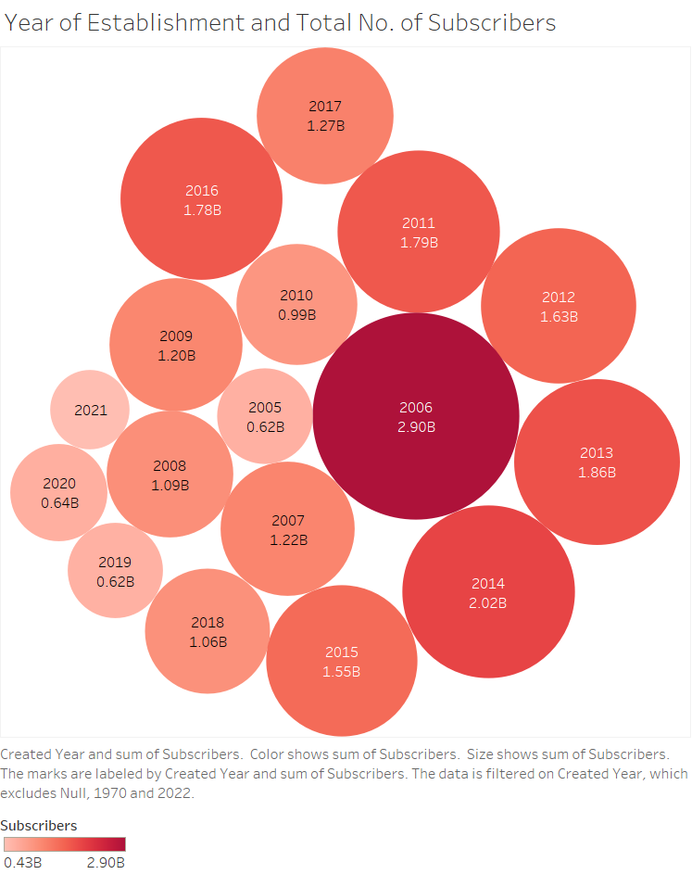
Year of Establishment and Total No. of Subscribers

Slide 8
End NOTES
🔹 Launch content during high-growth months for better engagement.
🔹 Focus ads and local content in high-viewership regions.
🔹 These insights help YouTube creators, marketers, and strategists make data-driven decisions.

